Slide 1


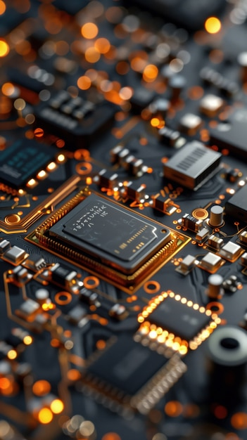

U.V. Patel collage of Engineering
••••
Topic:- Basic of Microcontrollers
Enrollment number:- T24012011137
Made by:- Krish P. Thakore
Subject :- Seminar (2HS1102)

Slide 2


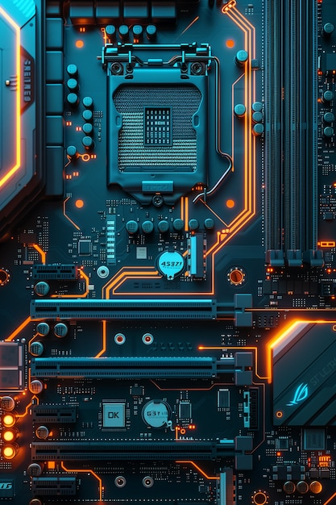


OVERVIEW
•Introduction to Microcontrollers
•What is a Microcontroller?
•History of Microcontrollers
•Evolution of Microcontrollers
•Basic Architecture
•Types of Microcontrollers
•Microcontroller Families
•Programming Microcontrollers
•Embedded Systems Overview
•Common Appl ications
•Real-World Applications
•Communication Protocols
•Challenges in Microcontroller Design
•Conclusion and Future Trends

Slide 3
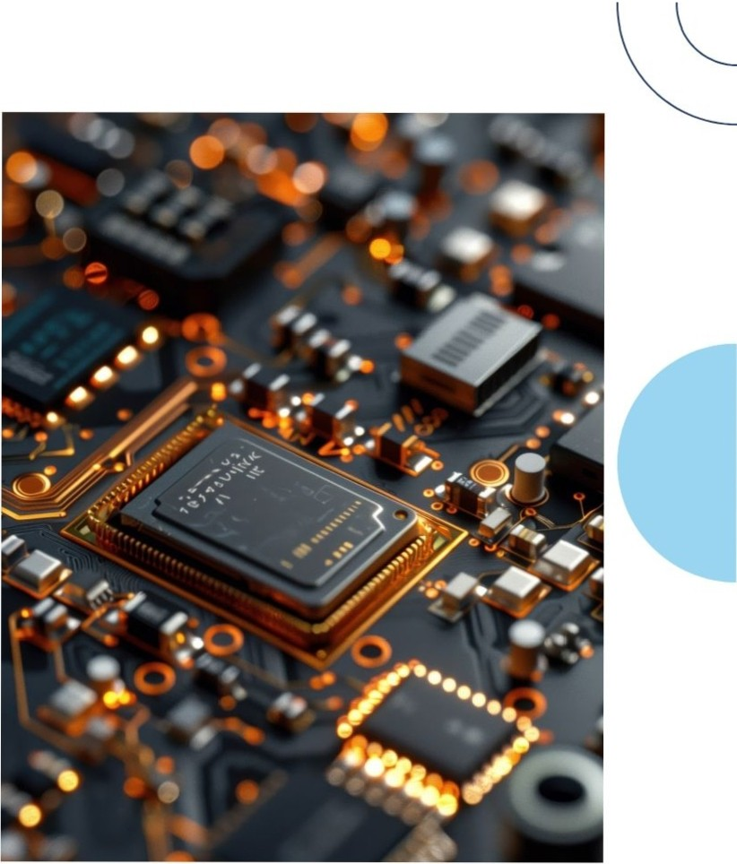

Introduction to Microcontrollers
This presentation provides a comprehensive guide to microcontrollers. We willexplore their architecture, applications, and importance in modern technology. Understanding microcontrollers is crucial for college students pursuing careers in IoT engineering, computer science, and embedded systems.

Slide 4
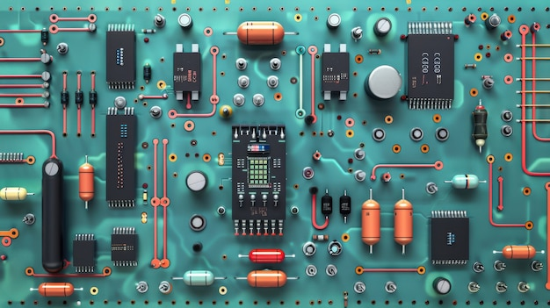
What is a Microcontroller?
A microcontroller is a compact integrated circuit designed to govern a specific operation in an embedded system. It typically includes a processor, memory, and input/output peripherals, making it essential for controlling devices and systems.

Slide 5
History of Microcontrollers
•1971: Intel introduces the 4004, the first commercially available microprocessor.
•1976: Motorola introduces the 6800, one of the first microprocessors designed for general-purpose use.
•1978: Intel introduces the 8051, a popular microcontroller architecture that becomes a standard in embedded systems.
•1980s: The emergence of 16-bit and 32-bit microcontrollers, offering increased performance and capabilities.
•1990s: The rise of RISC (Reduced Instruction Set Computing) architecture microcontrollers, known for their efficiency and speed.
•2000s: The integration of peripherals like analog-to-digital converters (ADCs) and digital-to-analog converters (DACs) into microcontrollers.
•2010s: The development of low-power, energy-efficient microcontrollers for IoT applications.

Slide 6
Evolution of Microcontrollers
•From Microprocessors to Microcontrollers:
Microcontrollers evolved from microprocessors by integrating additional components like memory, I/O ports, and peripherals onto a single chip.
•Increasing Complexity:
Microcontrollers have become more complex over time, offering higher performance, more features, and lower power consumption.
•Specialization:
Microcontrollers have specialized for various applications, such as automotive, IoT, and industrial control.

Slide 7

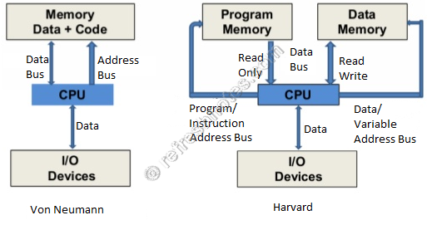

Basic Architecture
•Harvard Architecture:
Separate memory spaces for instructions and data.
Improves performance and flexibility.
Commonly used in microcontrollers.
•Von Neumann Architecture:
Single memory space for both instructions and data.
Simpler design, but can introduce potential bottlenecks.
Used in general-purpose computers.

Slide 8

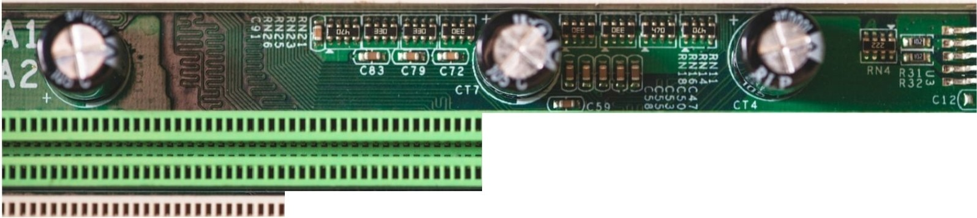


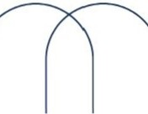
11111111111111111111111111111111111111111111111
11111111111111111111111111111111111111111111
11111111111111111111111111111111111111111111
11111111111111111111111111111111111111111111
111111111111111111
11111111 111111111 1111111111111111111 111111 11
Types of Microcontrollers
Microcontrollers can be classified into several types. including 8-bit,16-bit, and 32-bitmicrocontrollers. Each type has its own advantages and is suited for different applications based on processing power and memory requirements.

Slide 9
Microcontroller Families
•8051: A classic 8-bit microcontroller family known for its simplicity and versatility.
•AVR: A family of RISC microcontrollers from Atmel (now Microchip) with a low-power architecture.
•PIC: A family of RISC microcontrollers from Microchip, popular for their ease of programming.
•ARM: A family of RISC microcontrollers known for their high performance and energy efficiency.

Slide 10
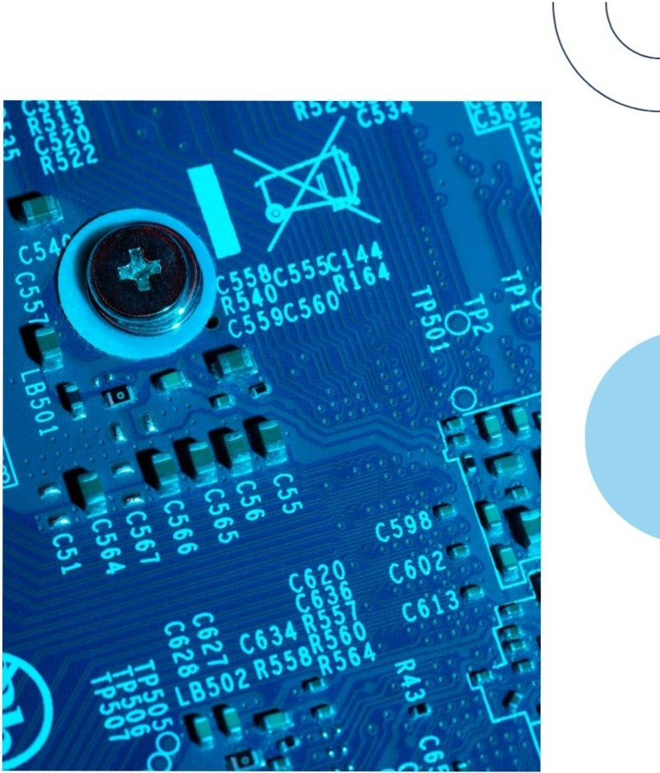
Programming Microcontrollers
Microcontrollers are programmed using languages like C,C++,and Assembly. Understanding the programming environment and tools is essential for developing applications that effectively utilize the features of microcontrollers.

Slide 11
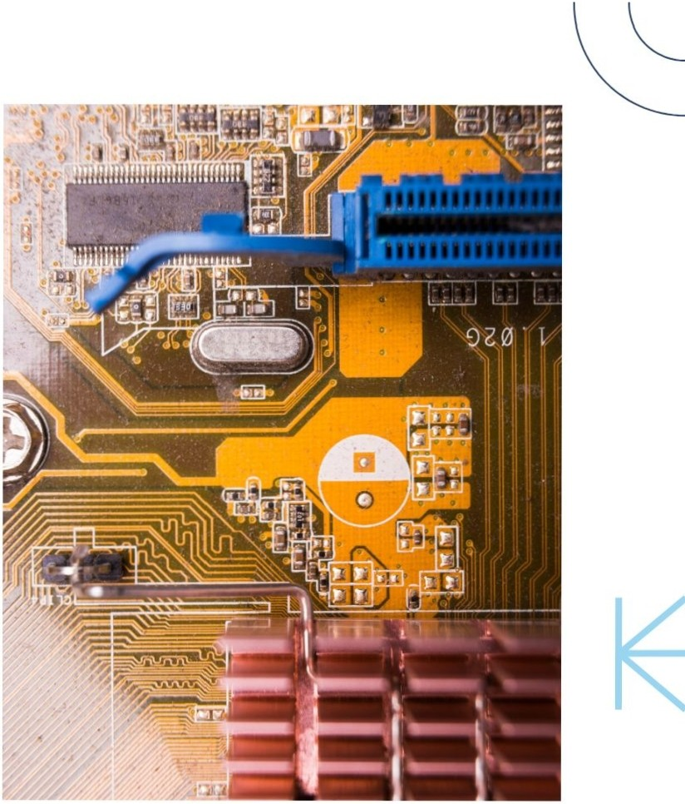


Embedded Systems Overview
An embedded system is a combination of hardware and software designed for a specific function.Microcontrollers play a vital role in embedded systems, enabling precise control and automation invarious industries.

Slide 12
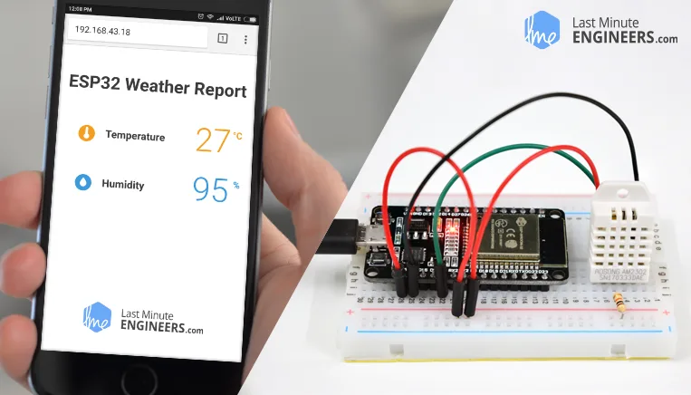
Interfacing with Peripherals
Sensors
•Temperature sensors: Thermistors, thermocouples
•Light sensors: Photoresistors, photodiodes
•Pressure sensors: Barometers, pressure transducers
•Humidity sensors: Capacitive humidity sensors
Motion sensors: Accelerometers, gyroscopes

Slide 13
Embedded Systems Overview
An embedded system is a combination of hardware and software designed for a specific function.Microcontrollers play a vital role in embedded systems, enabling precise control and automation invarious industries.

Slide 14



Common Appl ications
Microcontrollers are used in a variety of applications, including automotive systems, home automation, medicaldevices,and robotics.Their versatility makes them a key component in many modern technologies.
••••

Slide 15
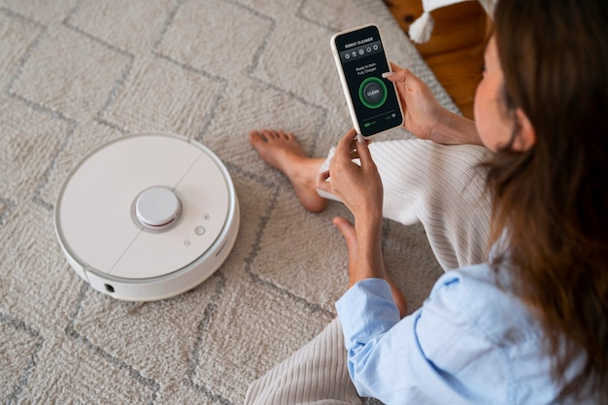
Real-World Applications
•Smart Home Gadgets:
Thermostats, lighting systems, security cameras
Remote control and automation of home appliances
•Wearable Technology:
Fitness trackers, smartwatches
Health monitoring, data tracking, notifications
•Industrial IoT:
Predictive maintenance, asset tracking
Improved efficiency and productivity in manufacturing

Slide 16

Communication Protocols
Microcontrollers use various communication protocols such as 12C, SPI, and UART to exchange data with other devices. Familiarity with these protocols is essential for effective system integration andcommunication.

Slide 17

Challenges in Microcontroller Design
Designing with microcontrollers can pose challenges such as resource limitations, real-time constraints,and debugging issues.Understanding these challenges is essential for successful project execution and product development.

Slide 18





Conclusion and Future Trends
••••
Inconclusion, microcontrollers are integral to modern technology. As we move towards an increasingly connected world, understanding microcontrollers will be essential for future innovations in loT, Al, and smart devices.

Slide 19





Thanks!
DO YOU HAVE ANY QUESTIONS?
krishthakore103610@gamil.com
+91 7284825185

